Slide 1
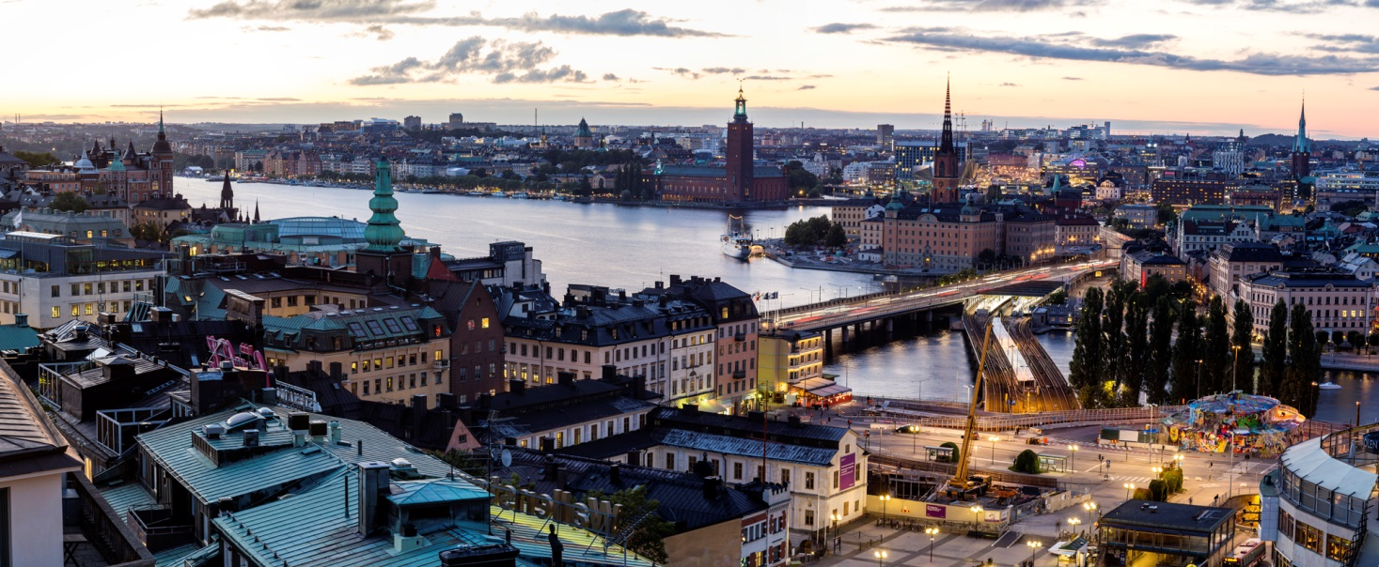
Welcome to Stockholm, Sweden
Facts
1,5 million inhabitants and in Sweden 10 million
Stockholm was founded 1436
Notes:
We haft to co-operate even more, with regional groups, with technical groups, with staff exchange and with our main conferences.
Don´t forget the possibility to visit Cicero or SMS conferences.
Yes We can always do this better - Together

Slide 2
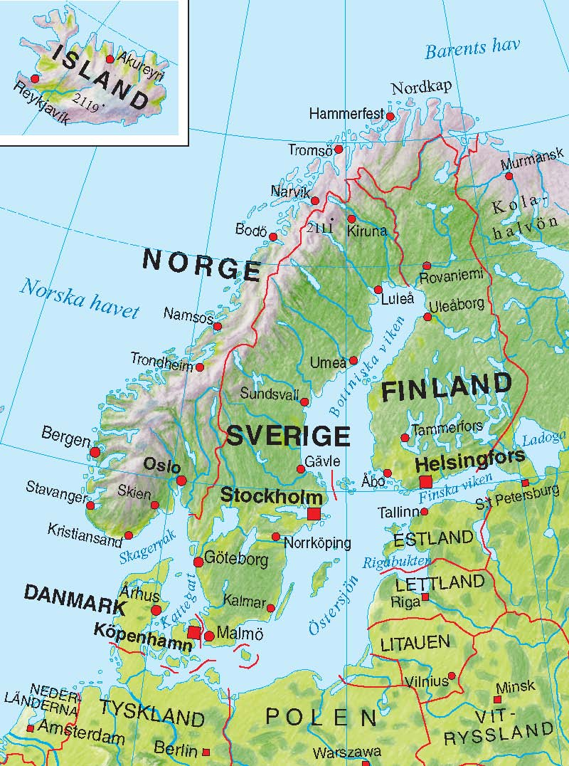

Slide 3
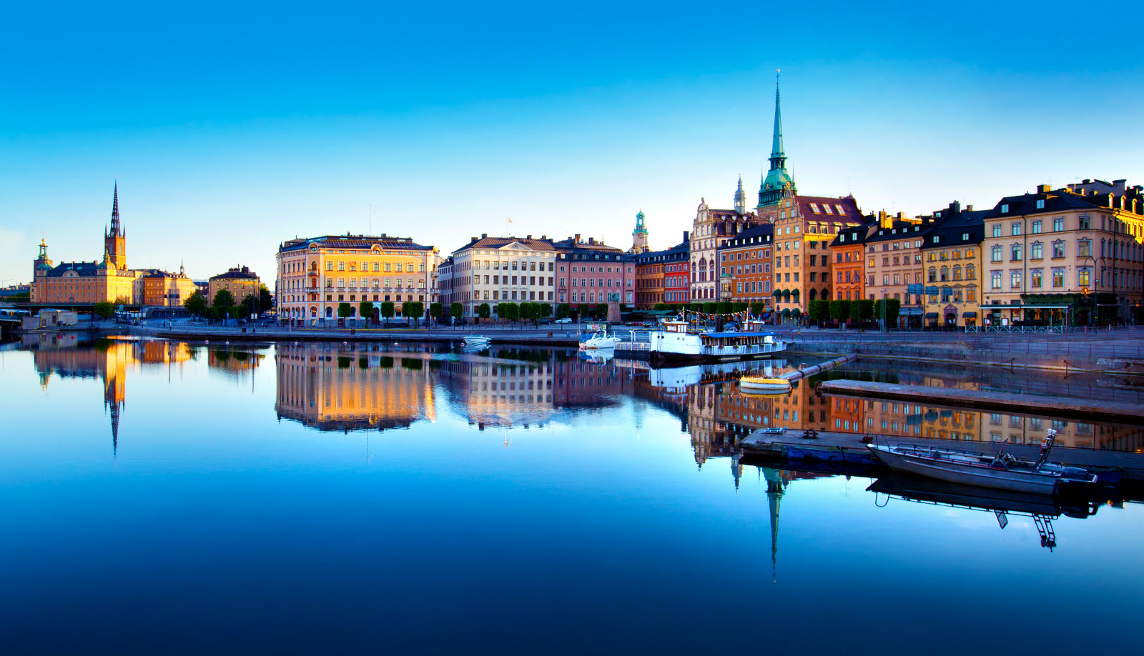
CH International Sweden
Ekonomiansvarig AB
13 employees, 2 partners
Skogsbergs Revision
5 employees, 1 partner
Notes:
We haft to co-operate even more, with regional groups, with technical groups, with staff exchange and with our main conferences.
Don´t forget the possibility to visit Cicero or SMS conferences.
Yes We can always do this better - Together

Slide 4
What is Sweden famous for?
Notes:
We haft to co-operate even more, with regional groups, with technical groups, with staff exchange and with our main conferences.
Don´t forget the possibility to visit Cicero or SMS conferences.
Yes We can always do this better - Together

Slide 5
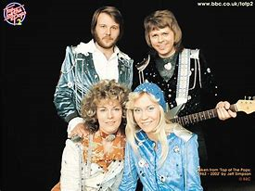

Slide 7
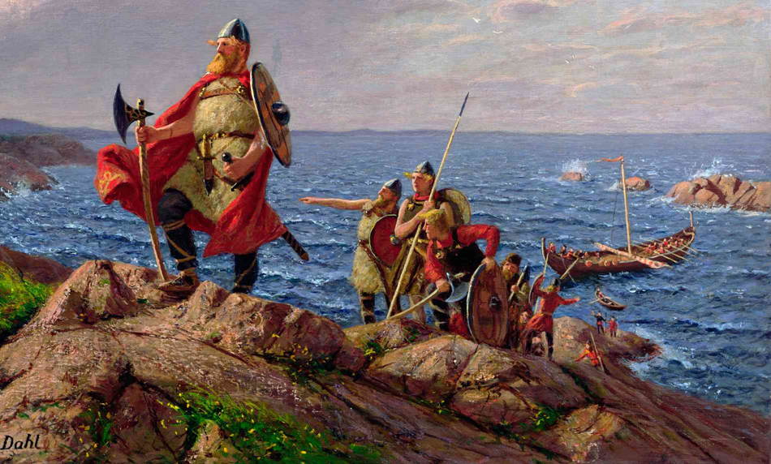
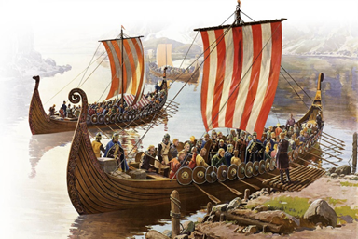

Slide 8
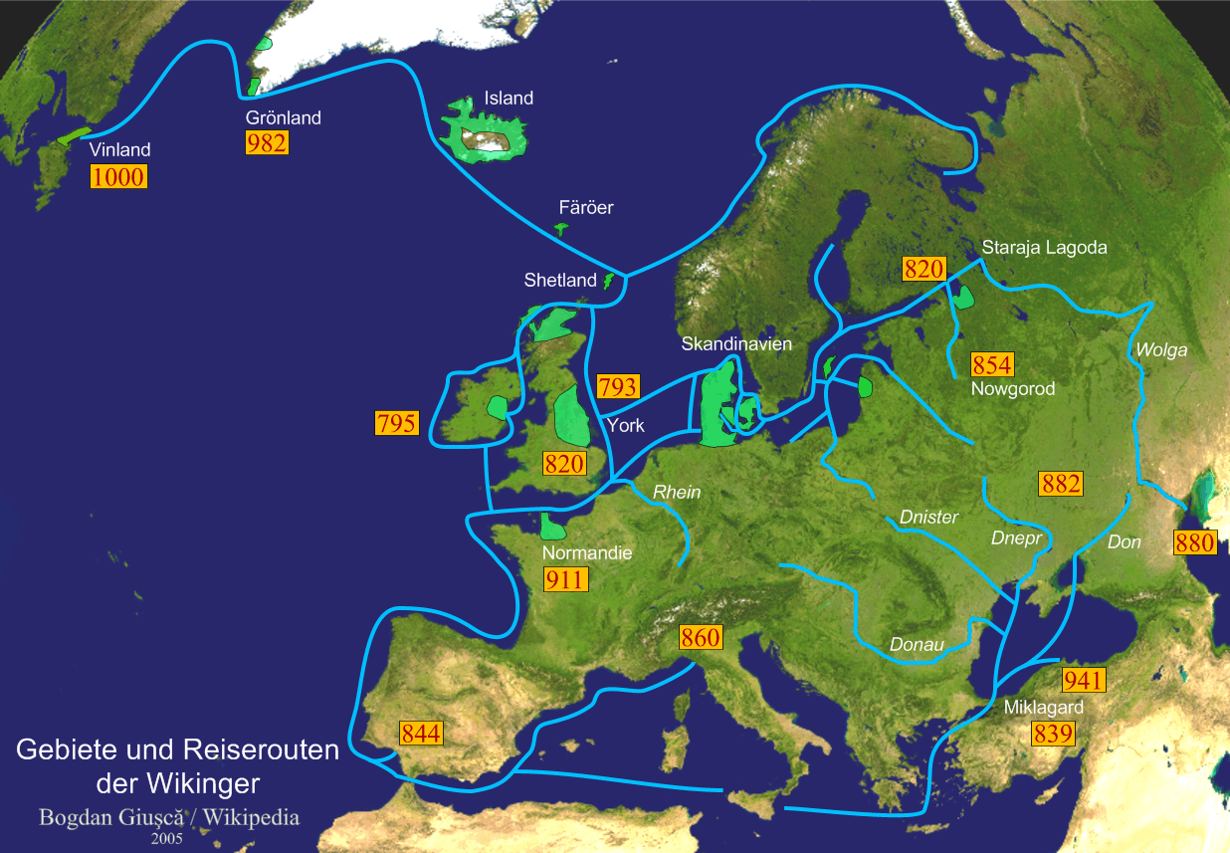

Slide 9
Welcome to Stockholm, Sweden
Notes:
We haft to co-operate even more, with regional groups, with technical groups, with staff exchange and with our main conferences.
Don´t forget the possibility to visit Cicero or SMS conferences.
Yes We can always do this better - Together

